Slide 1
Intro to Business Presentation What does FBLA mean to me?
Helen Tran
Monica Yu
Jennie Ha

Slide 2
Can you name a few famous individuals that have impacted your views on the world of business?
QUESTIONS TO CONSIDER
Can you name a female Asian American business leader that have impacted your views on the world of business?

Slide 4
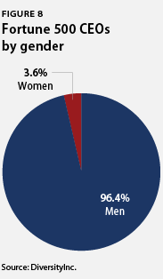
Asian & Gender Diversity in America

Slide 5
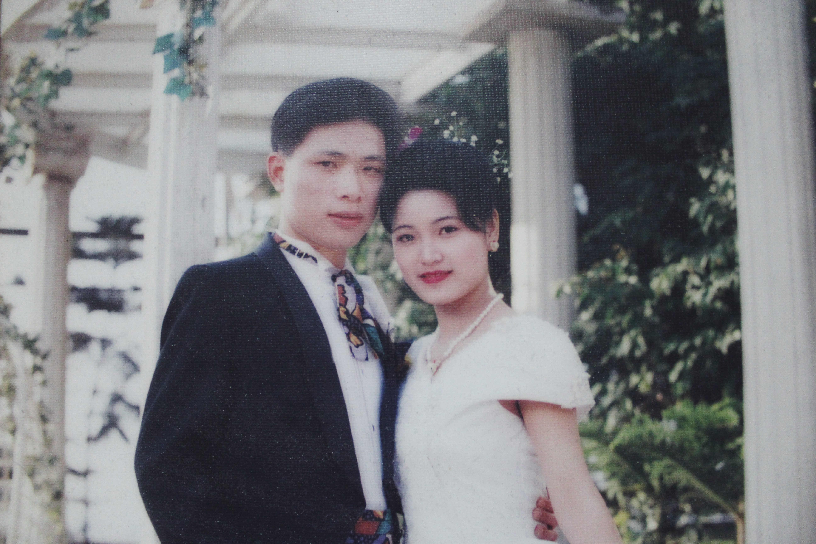
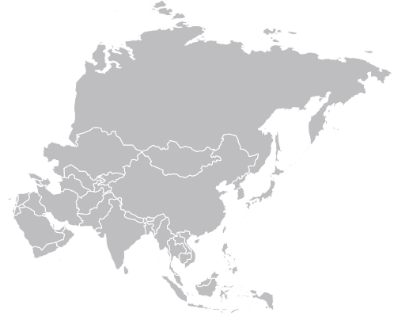
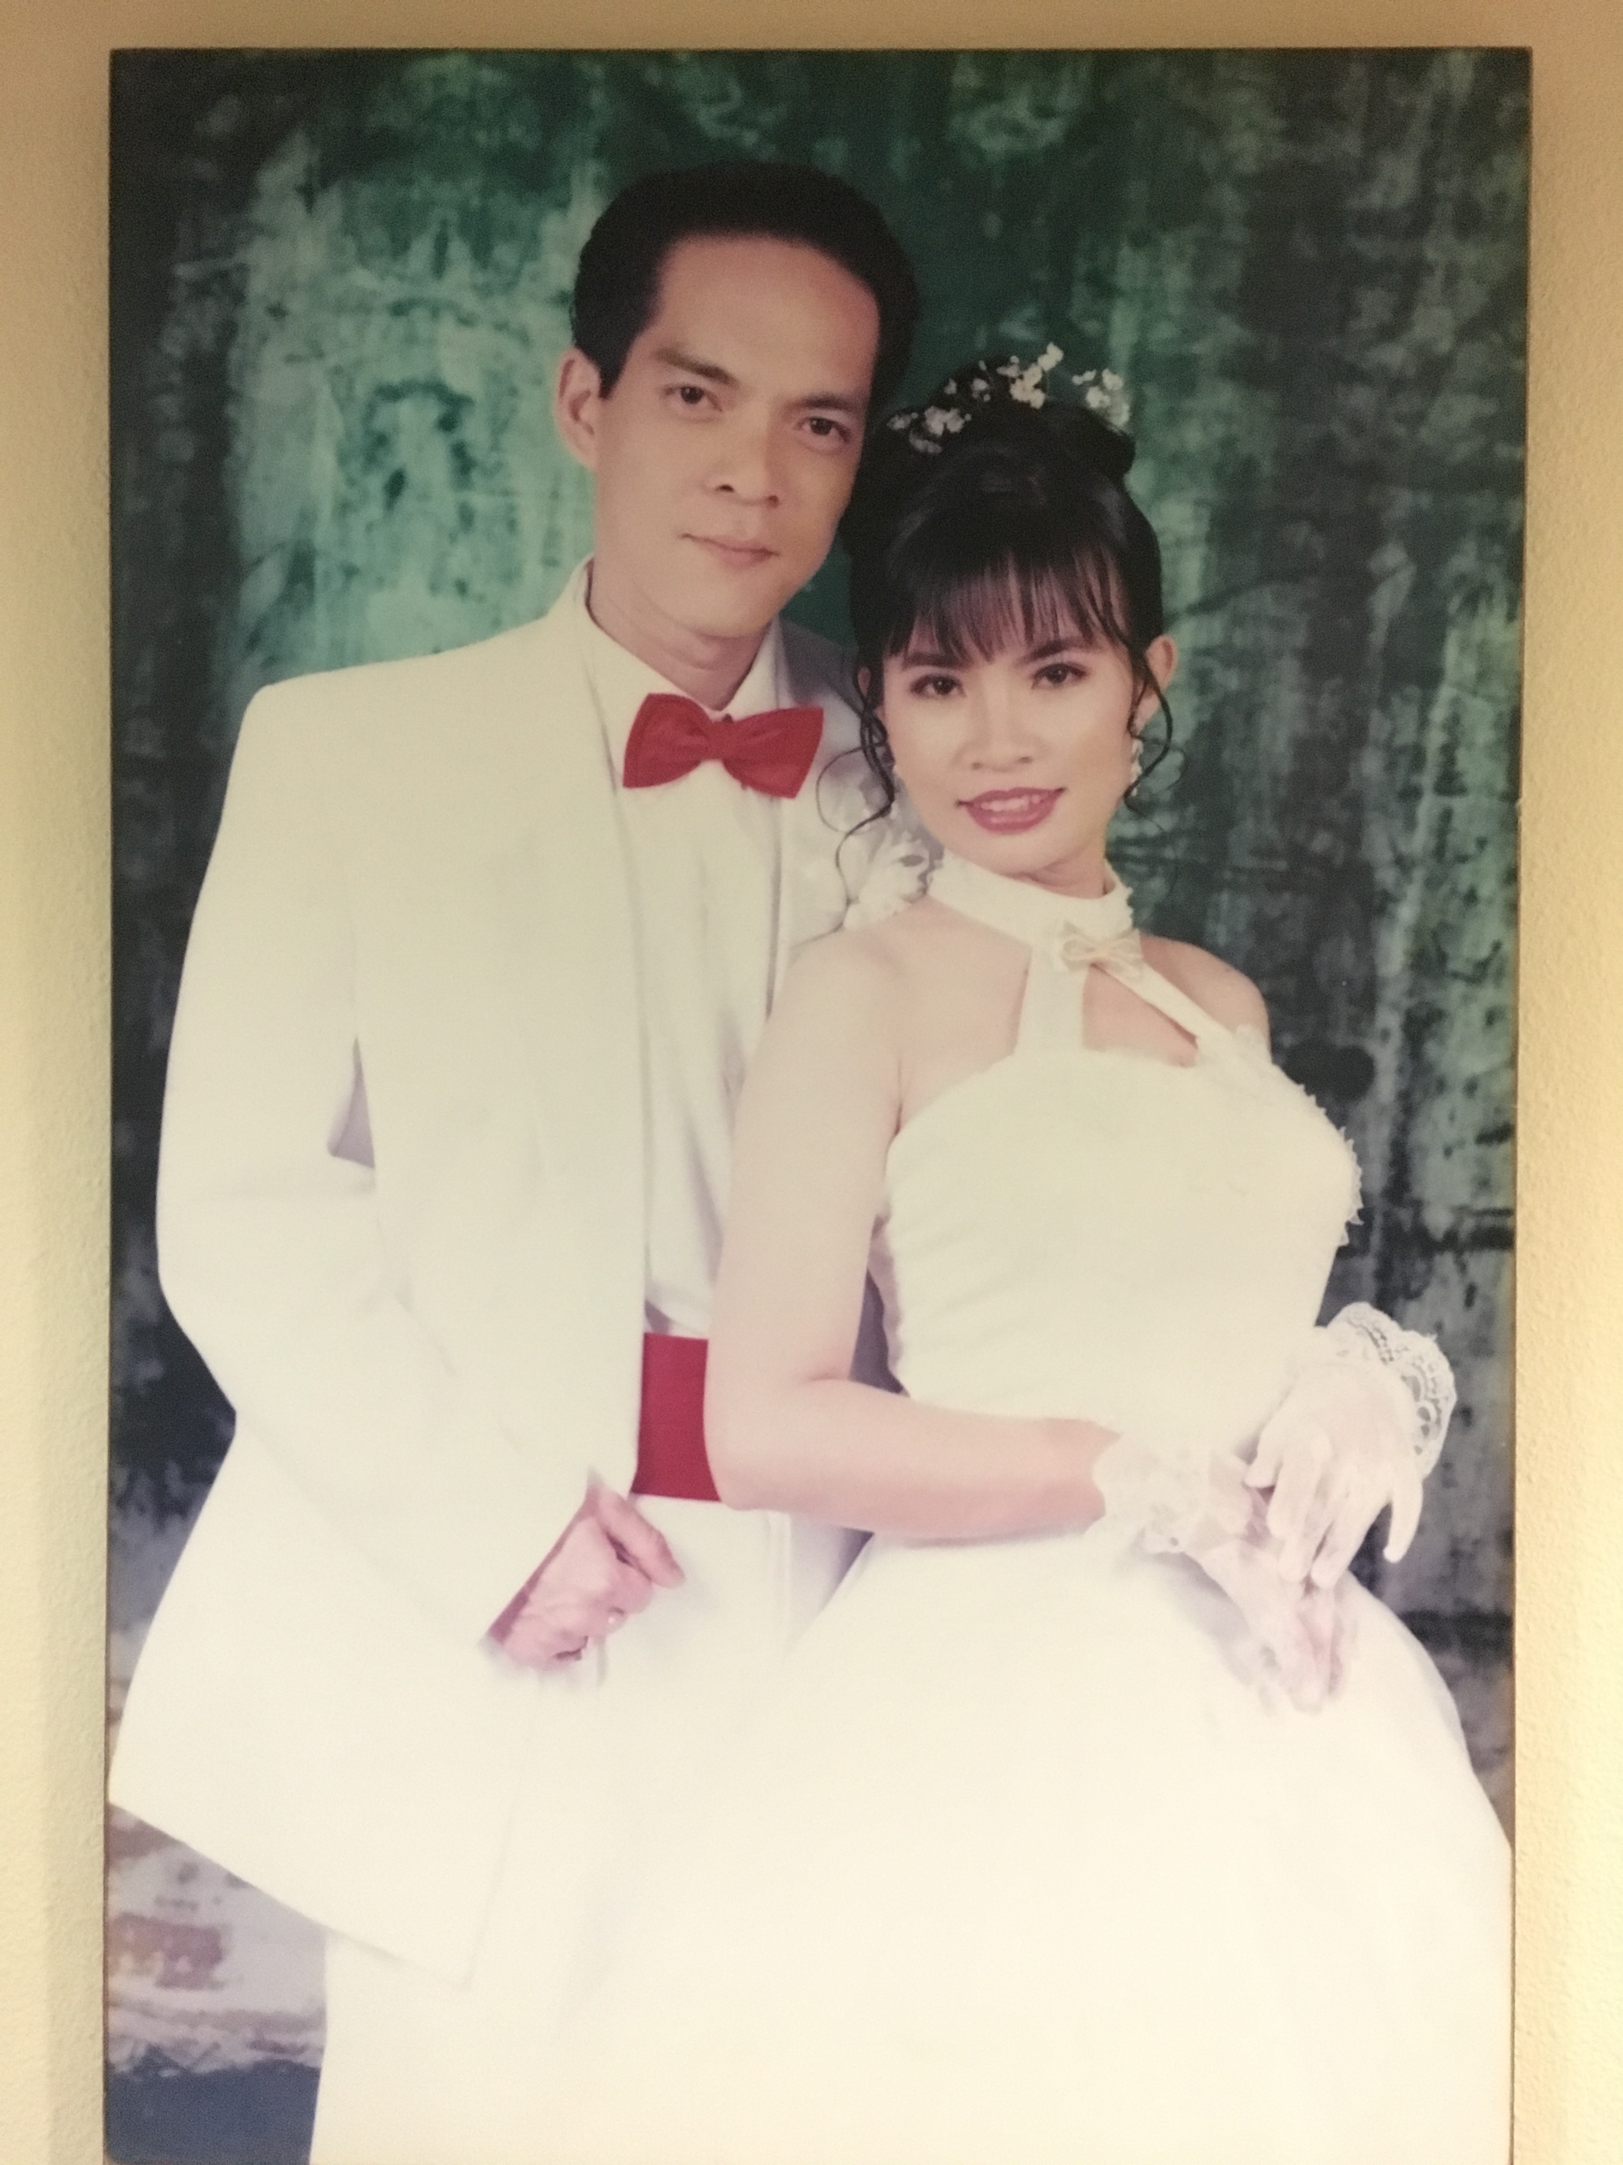
Monica's parent's
source: B. Braun Brasil
Jennie's Parent's
Helen’s Parents

Slide 6
FBLA: - Puts yourself out there
- Access to advisors
- Develop communication skills
- Networking
- Public speaking
- Sense of security to take risks
- More opportunities - Feelings of accomplishment

Slide 7
Thank you for listening!
What to take away:
-There currently is a lack of diversity in the business world, and FBLA can be a solution for it.
-FBLA is an opportunity for us to learn and develop skills to become someone in the real world.
-We are in FBLA to improve our business skills, which will be beneficial no matter what career we pursue.

Slide 8
Works Cited
Burns, Crosby, et al. “The State of Diversity in Today's Workforce.” Center for American Progress, Center For American Progress, 12 July 2012, www.americanprogress.org/issues/economy/reports/2012/07/12/11938/the-state-of-diversity-in-todays-workforce/.

