Slide 1
Restart your life with fresh foods!
Notes:
Gary: Hello! I’m Gary Tou
Misty: I’m Misty Chung
Jennifer: And I’m Jennifer Dinh. We’re from the Hazen FBLA chapter and we are Refresh LLC.
Gary: Where you can restart your life with fresh foods.

Slide 2
Table of Contents
Overview
Loan
Risks
Meal Plans
Expenses
Vision
Management
Obtaining Loan
Stability and Growth
Operations
Assumptions
Conclusion

Slide 3
Company Overview
Consumers
Our target market includes millennials, working families, and busy couples. These people will be the most affected by our product.
01
Product
An easy way to transition into a healthier lifestyle. The meal kits will include ingredients that are all locally grown and organic.
02
Refresh
Main Goal: Promote healthy eating through our product to local millennials, working families, and busy couples
03
Notes:
Misty:
Refresh LLC. is a meal delivery-kit service. Our company’s goal is to promote healthy eating by selling prepared meal kits to millennials, working families, and busy couples. We send instructions, along with pre-measured ingredients that are ready to be cooked. These meal-kits are ordered online and delivered to people within the [Change Slide] local Seattle area. Our company is also located in this area to give us easy access to all our customers.

Slide 4
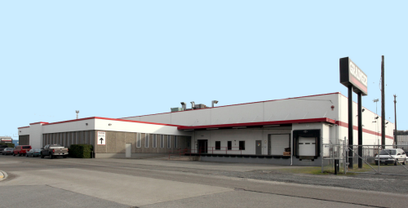
Company Overview
Warehouse
4930 3rd Ave S, Seattle, WA 98134
Notes:
Script on previous slide.

Slide 5
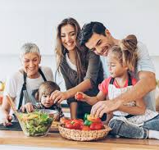
Meal Plans
Options
Variety of foods
Diets
Allergies
Individual
Family
Individual
Couple
Plus
All organic ingredients
More higher quality foods
Seasonal options
Individual+ $45
Family+ $150
• 1 Serving
• 3 meals per week
• $35 per week
• 2 Servings
• 3 meals per week
• $70 per week
• 4 Servings
• 3 meals per week
• $130 per week
Notes:
Gary: Refresh provides three different meal plans: Individual, Couple, and Family. The prices ranges from $35 to $130 ($35, $70, $130). We also accommodate various dietary restrictions including vegetarian, nut-free, and gluten-free. In addition, we provide our customers with a premium option called “Plus”. This premium option provides customers with seasonal meals and all organic ingredients at a higher cost.

Slide 6
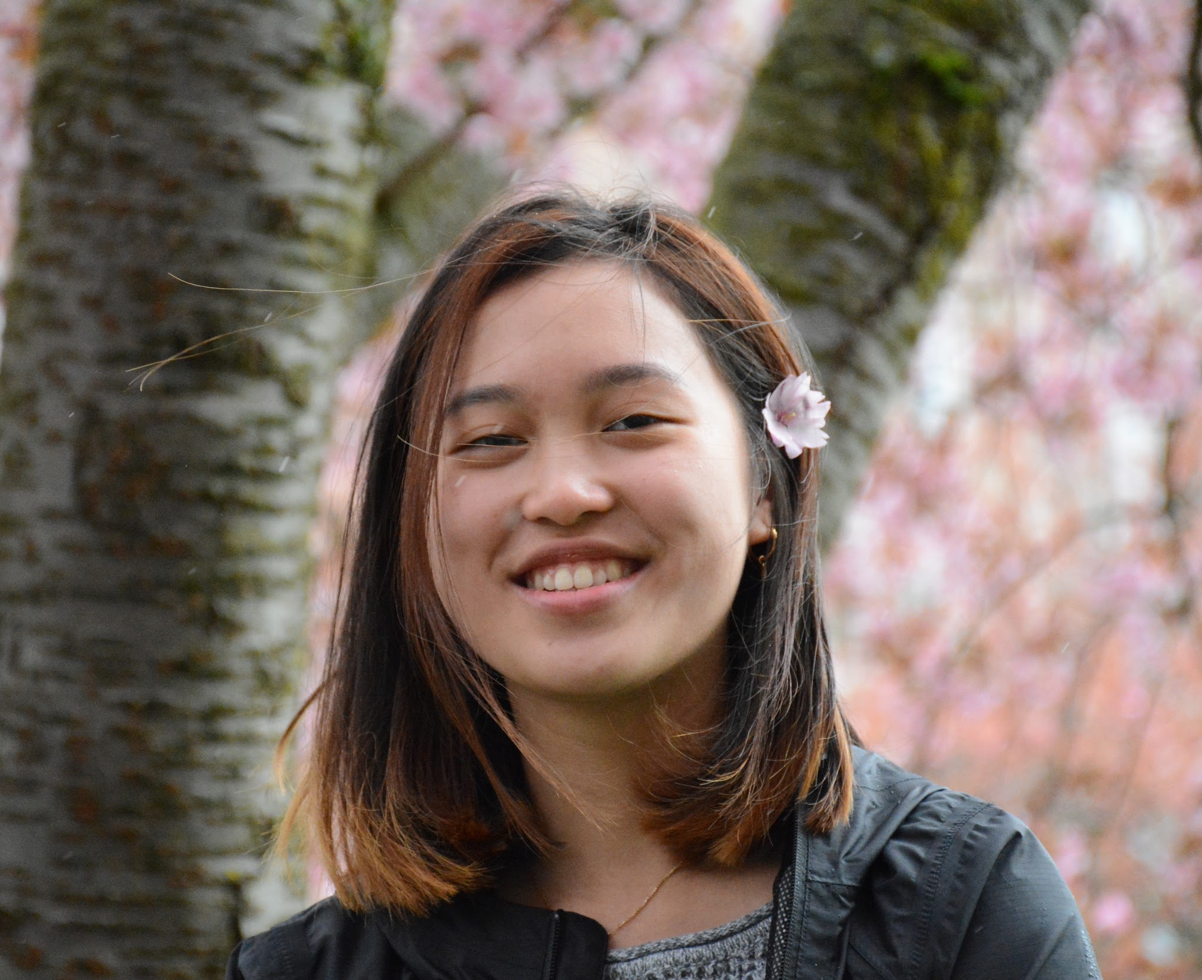
Jennifer Dinh
CEO/Operations Supervisor
Will get final say in decisions involving company, deal with legal aspects from LLC. agent, and supervise employees.
Bachelors in Culinary Nutrition from Bastyr University
Prior experience from working at a small catering company
Notes:
Jennifer: Refresh is a Limited Liability Company shared by three co-owners. We each own an equal part of this establishment and work together to manage it. Each owner will be holding a different leadership position within the company based on their previous experiences. I’m the CEO of the company. I will be responsible for any legal aspects passed down from our registered LLC agent and will be making the final calls in all decisions. Along with being the CEO, I’m the Operations Supervisor. This job includes hiring, training, and supervising the staff as well as creating new recipes for the company.

Slide 7
Misty Chung
Financial Manager/Accountant
Working for company as accountant and will assist CEO in making decisions about finance.
Bachelor in Accounting from the University of Washington
Masters in Finance from the University of Washington
Notes:
Misty: I’ll be serving the company as the financial manager. The job will mostly involve me acting as an accountant but I will also be assisting Jennifer in decisions about the financial aspects of the company.

Slide 8
Gary Tou
Technological Marketing Manager
With be advertising company through social media and in charge of online ordering system.
Bachelor’s Degree in Web Development from the Seattle University
Notes:
Gary: And I am the Technological Marketing Manager. I will be in charge of advertising the company through different types of mediums and managing and improving our company’s online and app ordering system.

Slide 9
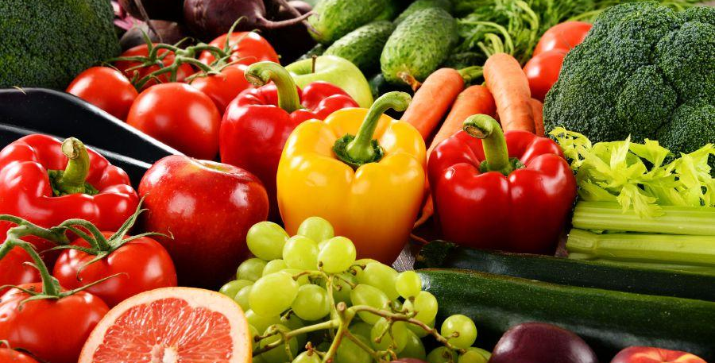
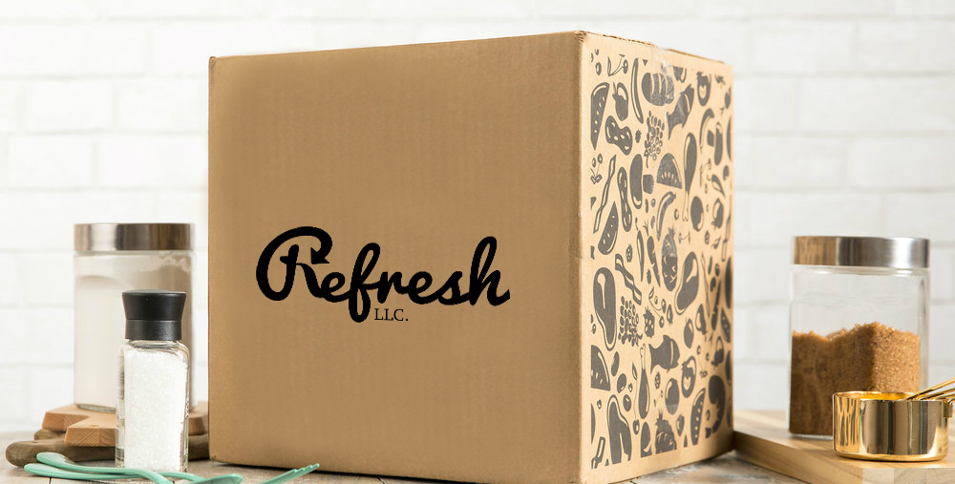
Operations
Process
Suppliers
Delivery
01
03
The ingredients will be washed by our machines, prepared by our staff, and then packaged.
02
Suppliers will delivery ingredients weekly and brought in by our employees
Finally, the kits will be stored in the back until they are ready to be loaded into the trucks and sent to our customers.
Notes:
Jennifer: In order to maintain the integrity of the fresh foods, we have simplified the kit-making process into three main steps. This process begins with our suppliers delivering the ingredients. Next, these ingredients will be machine-washed, prepared, and packaged by our trained staff. And then, the kits will be shipped to our customers to enjoy.

Slide 10
Finance
Notes:
Gary: Finance

Slide 11
$623,571.96
with an interest rate of 7.5%, and a repayment term of 10 years, and monthly payments of $7,401.91.
Notes:
Misty: Our loan from Wells Fargo is a SBA 7(a) loan of $623,571.96,
with an interest rate of 7.5%,
a repayment term of 10 years,
and monthly payment of $7,401.91

Slide 12
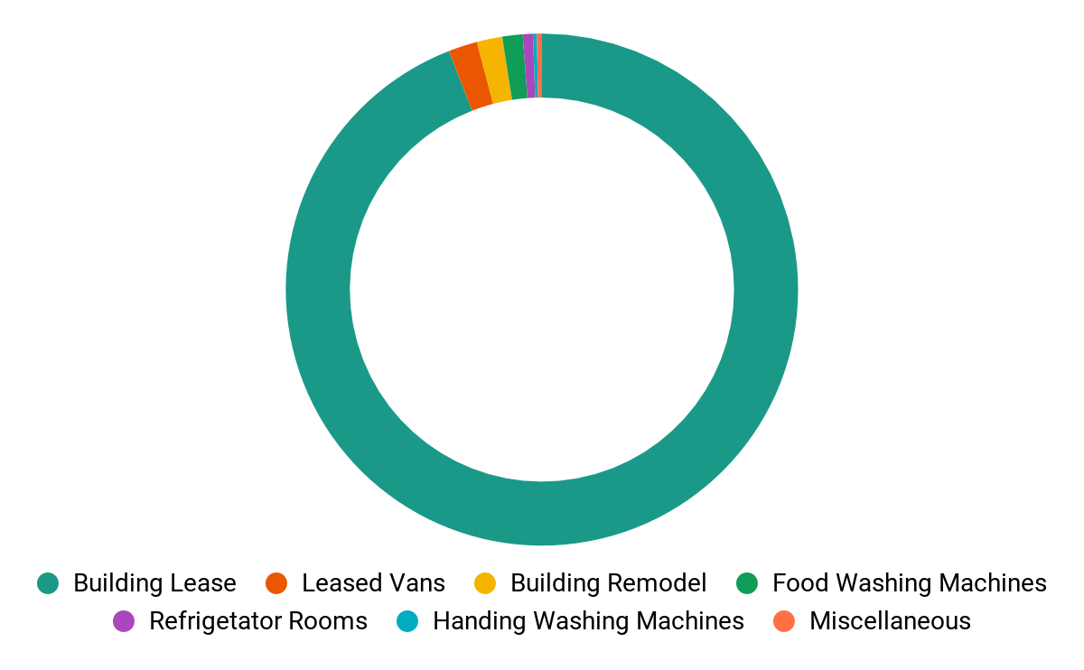
Expenses
$623,571
Expenses
Notes:
Gary: Our loan amount was determined by finding the sum of the expenses required to run this business for the first year. Any other expenses such as packaging, and advertising will be paid for by the revenue of our sales or the $5,000 which each owner will be investing into the company

Slide 13
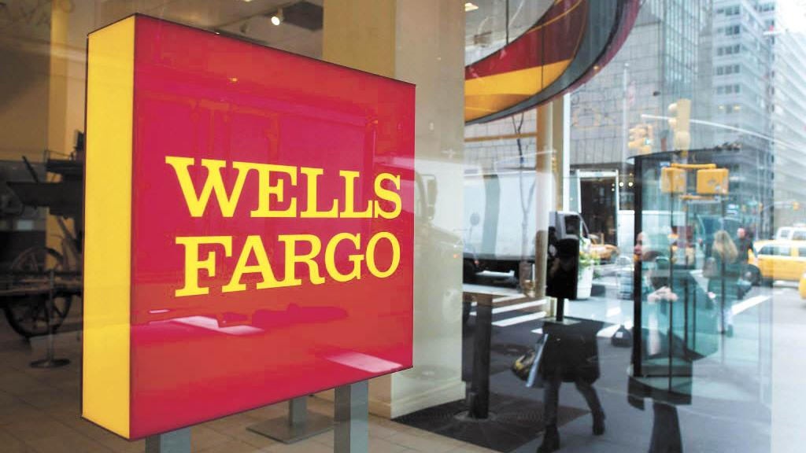
Obtaining loan
Three Steps to Obtaining a Loan:
Choosing Wells Fargo
Meet with a consultant
Show our business plan and use Misty’s expertise
Notes:
Jennifer: Before obtaining a loan, we first needed to choose a bank. We chose Wells Fargo because they loaned $35 billion in small business loans to companies with less than $20 million in revenue. As a small business, this greatly improving our chances. We then met with a consultant at Wells Fargo who advised us to request a SBA 7(a) loan. With Misty’s insight of business loans and our good credit, we were able to obtain the loan by showing the bank our business plan which includes tax returns, and financial statements.

Slide 14
Assumptions
01
Health
Our customers will care about their health and well-being.
03
Loyal Customers
Delicious meals establish healthy eating habits, creating repeat customers.
02
Investment
People will spend more money to save time and receive quality food.
Notes:
Misty: By creating this company, we have to assume that our customers will care about their health enough, to invest time and money to purchasing quality meals.This can be seen through the 42% increase in sparkling water sales by millennials. By removing soda from their diet, we can see millennials are becoming health conscious and are more likely to try our product.
Jennifer: We must also assume that millennials will invest in our product. After researching and comparing the prices, we found that sparkling water is much more expensive than soda. Therefore, representing how millennials are willing to spend money on consuming foods that will improve their health.
Gary: And our last assumption is that customers will remain loyal due to our reward system. Studies have shown that 22% of millennials are more likely to remain loyal to a brand due to its loyalty programs.
------
“Millennials are more likely than other generations to remain loyal to a brand because of its loyalty rewards (22%) and its company reputation or philosophy (15%) (Yes Lifecycle Marketing)”
https://blog.accessdevelopment.com/customer-loyalty-statistics-2017-edition
And finally, our last assumption is that our product will prevent customers from resorting to fast foods in the future. Studies show that 22% of millennials are more likely to remain loyal to a brand due to its loyalty programs. This represents the effectiveness of OUR rewards program, which will increase the number of returning customers; and ultimately establish healthy eating habits.

Slide 15
Vision
Selling to 3rd Parties
Increase Customer Base
Open Store Front
Expansion
Launch Rewards Program
Contact a 3rd party to set up vending machines in downtown Seattle
After a year of launching our company, we want to increase our customer base to 35,000.
And our final goal is to open a storefront in the heart of Seattle
Year 2
Year 4
Year 1
Year 3
Year 5
Expand our target location to serve a community of 400,000+.
Open another warehouse to accommodate for increased demand.
After four years, we plan to introduce a rewards program.
Notes:
Jennifer: We have five main goals for the future.
Goal one is to Increase our customer base to 35,000
Goal two is to Expand target location to an area of 400,000+ people and Open another warehouse.
Goal three is to Contact a 3rd party to set up vending machines in downtown Seattle.
Goal four is to launch a rewards program to incentivize the loyalty of our customers.
Our final goal is to Open a storefront in downtown Seattle to promote and sell more meal kits.

Slide 16
Risks
01
Direct relationships with local suppliers
Work with retailers and 3rd parties
Target Market
Our target market (millennials) have less disposable income.
02
Obtain the freshest and quality ingredients
Put ourselves out into the media
Competition
What will set us apart from major companies?
(Hello Fresh, Blue Apron)
03
Re-innovate how consumers purchase fresh and healthy meals (storefront)
Justify their needs for our product
Market
The market for meal delivery kit services is slowly dying.
Notes:
Gary: We have identified three major risks concerning our company.
Our first risk is that our target market, young millennials. Young millennials have a less disposable income income will may conclude in an adverse result of less sales. The first step to our solution is to create a direct relationship with local suppliers. This allows us to obtain better deals to make our meals as affordable as possible. Our second step is to work with retailers and 3rd parties to increase demand and decrease the cost.
Our second risk competing against larger companies such as Hello Fresh and Blue Apron. One of the advantages of being a small company is the ability to resource ingredients within the local community. We will use fresh ingredients as a marketing technique and establishing a strong relationship with our customers.
And the third risk is that the meal kit industry is slowly declining. We will combat this by re-innovating how customers purchase fresh and healthy foods by opening a storefront.

Slide 17
Stability and Growth
Loyal Customers: Strong connection, feedback, rewards program
Expansion: Warehouse, vending machines, storefront
High Quality Products: Fresh, organic, local, seasonal
Notes:
Misty:
For a company to be truly stable, it must have loyal customers. This will not be a problem as we strive to create connections with our customers, and incentivize our customers to retain their loyalty. After establishing our customer base, we will continue with our plans of expansion by opening more warehouses and contacting 3rd party vendors. This means we will be able to gain more profit. With this profit, we will provide our customers with a larger variety of high quality foods. Which will encourage more loyal customers. As you can see, this is a never ending cycle of building the stability of our company.
Jennifer: This cycle of stability will allow rapid growth for our company. As you can see on the graph, there is a steep increase of customers for the first 6 months due to our concentrated efforts on advertising and promoting our business. For the following months, we plan to shift our attention to improving our product by contacting more local suppliers. All together, this will allow our company to be successful and long lasting.
-------------------
Month 1: 100
Month 1-6: Rapid Increase, focusing profits on advertising
Month 7 and beyond: Focused on improving quality and customer relationships
Month 24 (2 years): 120k

Slide 18
Thank you.
Restart your life with fresh foods!
Notes:
Gary: This concludes our presentation. We thank you for your time and we would be happy to answer any questions you have for us.

