Slide 1
FBLA Meeting 10/31
Turkey Baskets, Fundraising, Competitive Events

Slide 2
Turkey Baskets
Volunteer Shifts
Community Service Hours
Community Service Awards

Slide 3
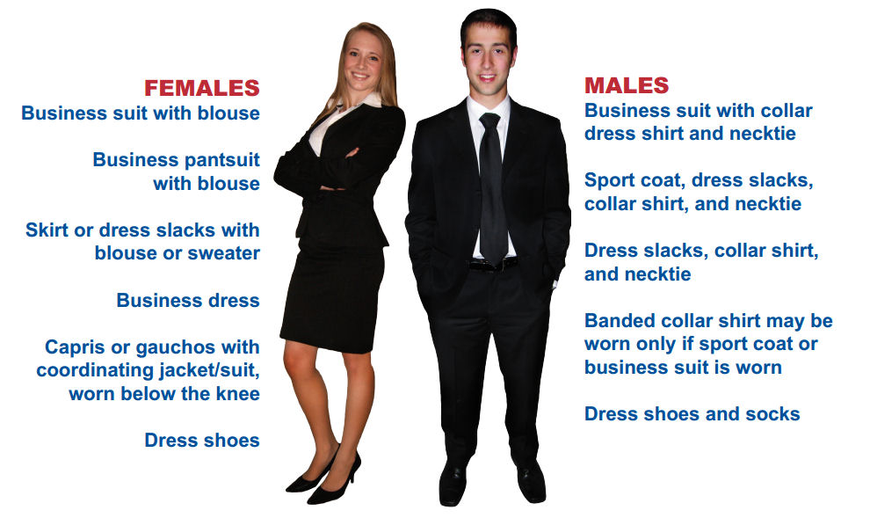
Fall Conference
Permission Slips due Thursday, November 9th
DRESS CODE
Kitsap Convention Center
November 14th @ 8:00 am
$30 fine already added to your account

Slide 4
Code of Conduct
Rules concerning:
Behavior (sexual and nonsexual)
Boys are red. Girls are blue. Do not purple.
Alcohol/Drugs/Tobacco
All products must be left at home and are not to be on you or your person at any time
If over 18, same rules apply
Discipline (depending on severity of action):
Warning/parent conference
Immediate removal from event
Immediate removal from Hazen FBLA chapter
Ineligibility to travel to other events
Ineligibility to rejoin Hazen FBLA
Discipline given by Hazen Admin

Slide 5
Fundraising
TURN IN YOUR MONEY HONEY (including dues)
Money is turned into ASB office
Receipts shown to Rusty in exchange for code

Slide 6
Competitive Events
CHECK YO SELF BEFORE YOU RECK YO SELF
No group may have more than 3 people
You may only do 4 events
Only 3 can be presentation events

Slide 7
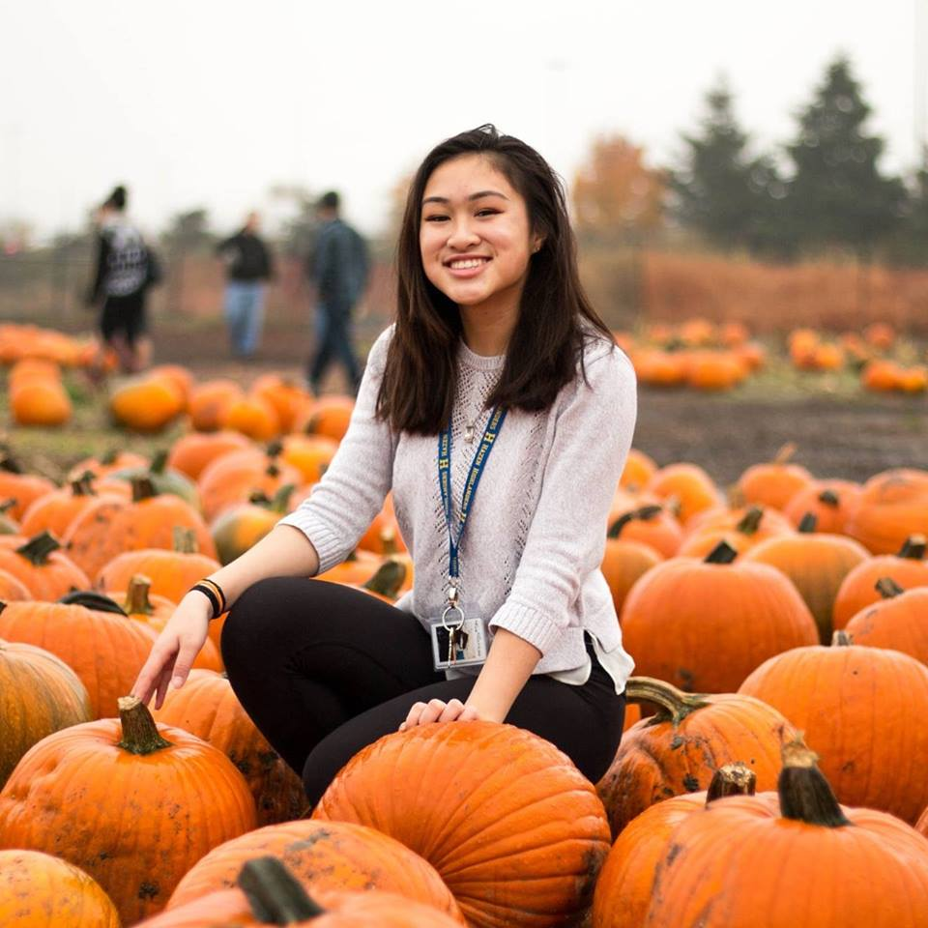
CONGRATULATIONS!!!
Ashley Vo is Washington FBLA’s Member of the Month for October 2017!

