Slide 1
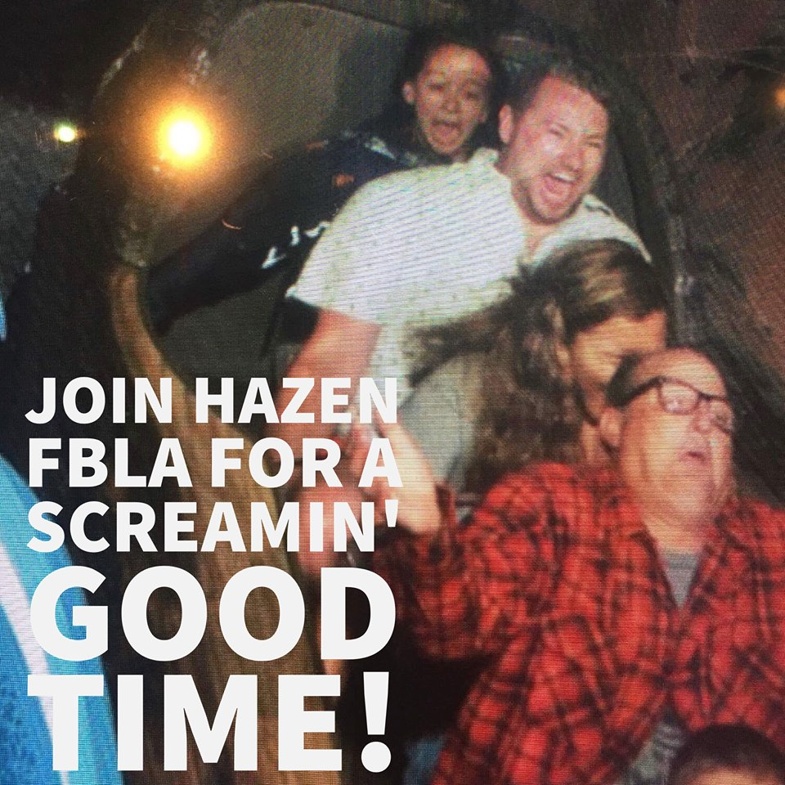
Welcome!
EXEC TEAM & Important info

Slide 2
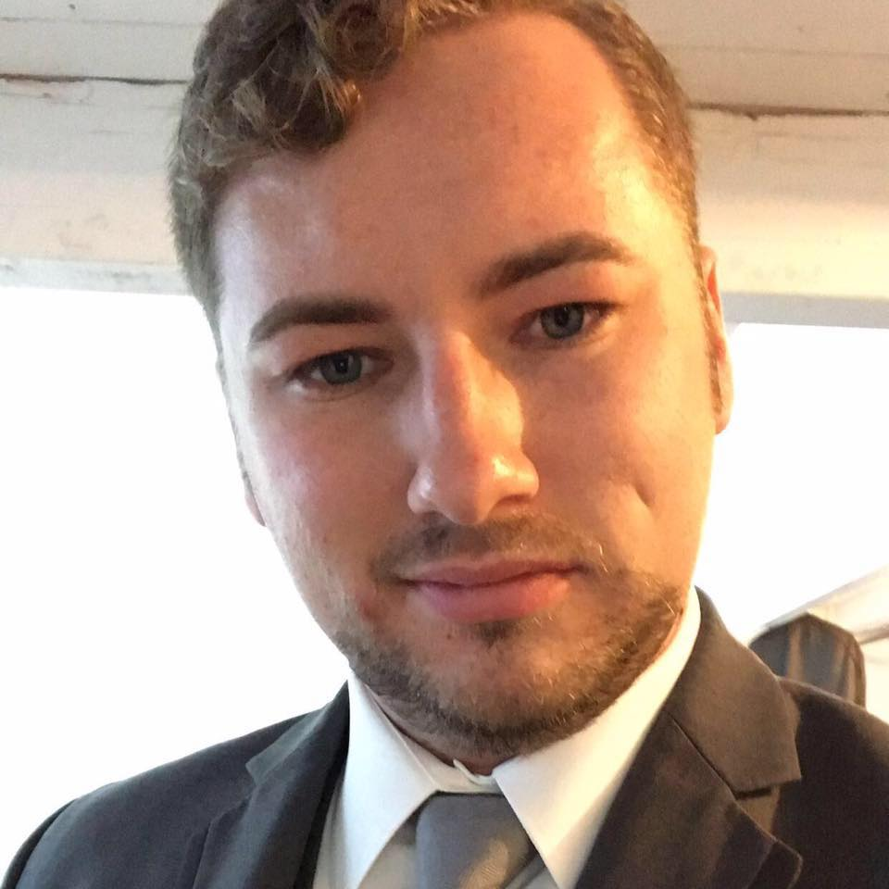
Rusty Chapter Adviser
Former 3 time national competitor
Former 2 term state officer
State Office Assistant, Past chapter member, current chapter adviser

Slide 3
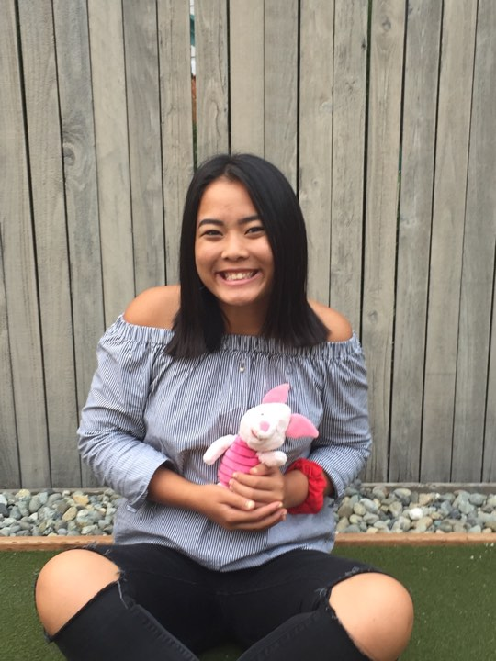
Trista Aoki Fundraising Chair
3rd year member
Senior
Favorite event: Business Ethics
Favorite Food: Soup
Favorite memory: Amy Chin winning Puget Sound Region Vice President!

Slide 4
Eva Zumwalt Secretary
2nd year member
Junior
Favorite event: E-Business
Favorite Food: Corn
Special Skill: spending more than $500 on bubble tea

Slide 5
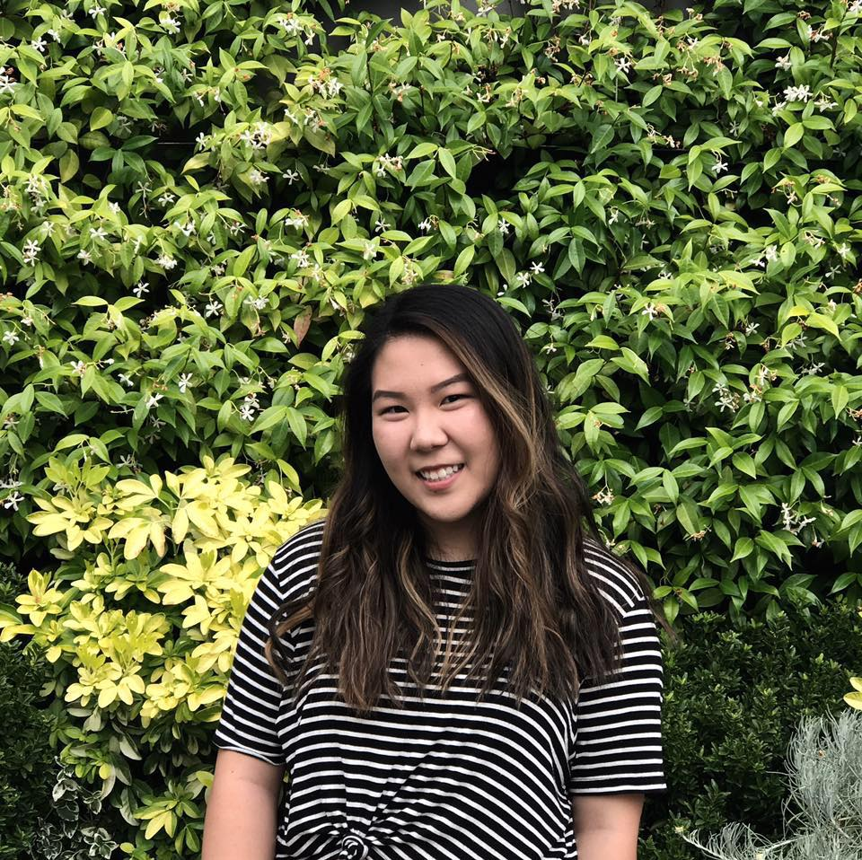
Faith Bae Public Relations Officer
2nd year in FBLA
Junior
Favorite event: PSA
Special Skill: I can binge watch an entire season in one night, no sleep”
Favorite Memory: placing at Regionals

Slide 6
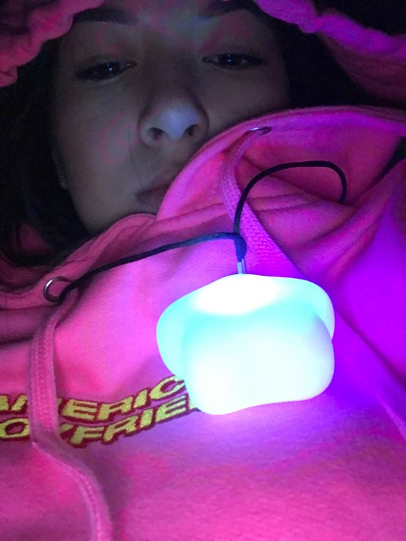
Brittany Tang Treasurer
3rd year member
Senior
Favorite event: Entrepreneurship
Favorite Food: Fries
Favorite Memory: going to stat for the first time

Slide 7
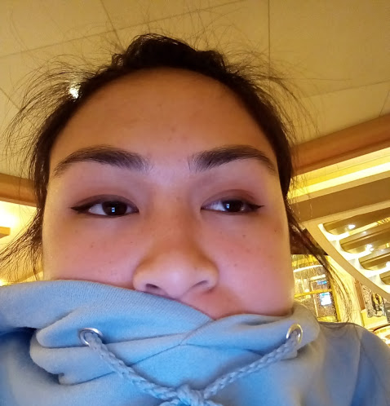
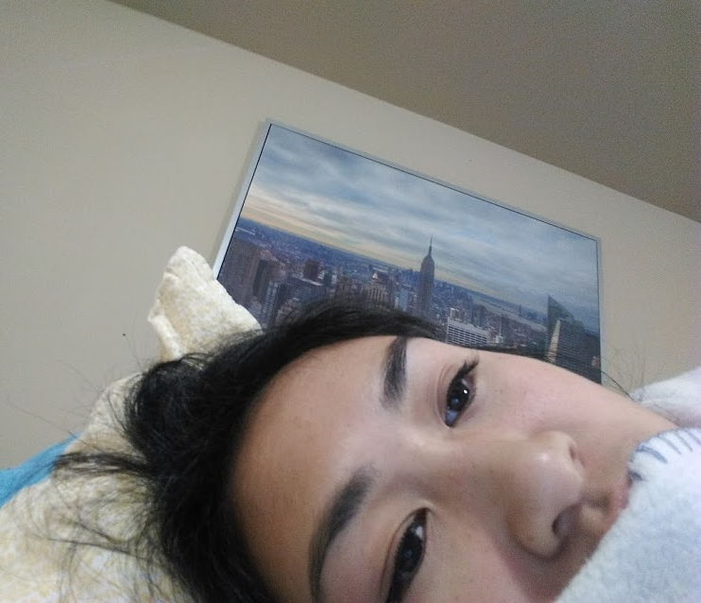
Ashley Vo Vice President
3rd year member
Senior
Favorite Food: Anything from Costco food court
Favorite event: Business Calculations/PSA
Special Skill: Practicing walking in heels on a treadmill

Slide 8
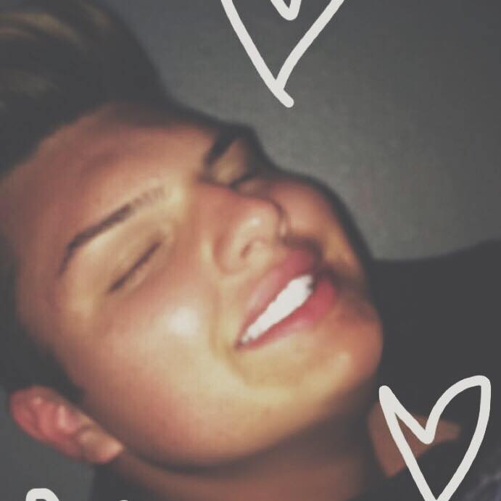
Anthony Glaefke President
3rd year member
Senior
Favorite Event: Sales Presentation
Favorite Food: Gyros
Favorite Memory: Going home and taking off dress shoes after a competition

Slide 9
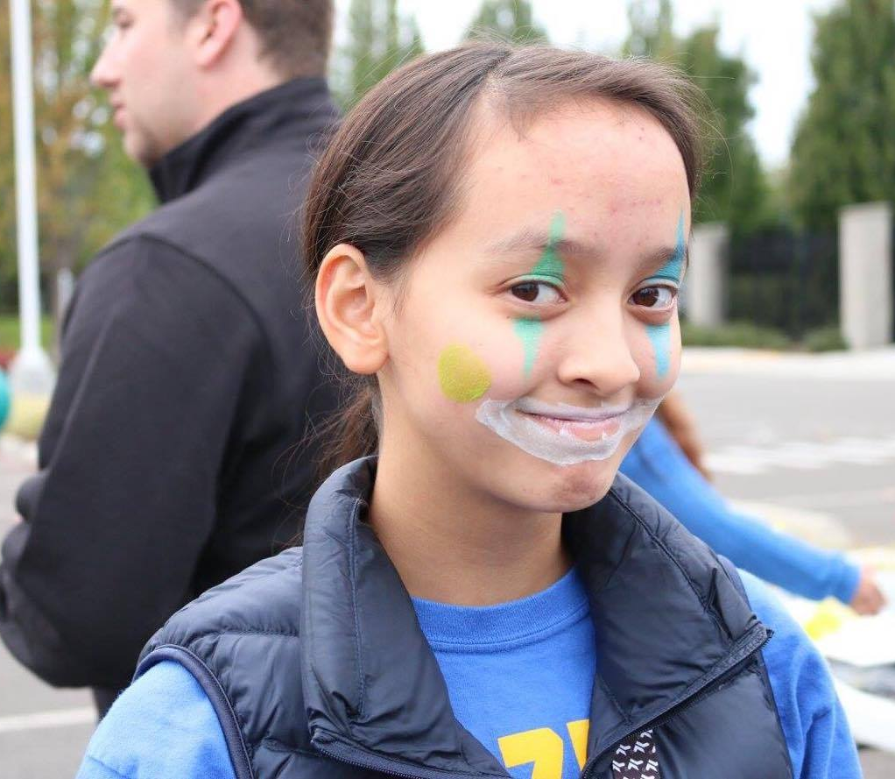
Amy Chin Puget Sound Region VP
4th year member
Senior
Favorite event: Business Law
Favorite Food: all of McDonald’s
Favorite Memory: Becoming a State Officer

Slide 10
Creating A Successful Chapter!
Chapter membership 2016-17: 138 members
Largest increase in chapter membership in WAFBLA
Second largest chapter in WAFBLA
Largest Chapter in Puget Sound Region
Nationally ranked and recognized chapter
Strong history of high leadership and competition achievement

Slide 11
About: Hazen FBLA
Membership dues: $35.00
Payment Plans available
Free and Reduced Lunch options
Conferences:
Fall Conference- Tuesday, November 14, 2017- Kitsap CC, Bremerton
Winter Conference- Saturday, February 3, 2018- PLU, Tacoma
State Conference- Wednesday PM, April 4 – Saturday AM, April 7, 2018- Bellevue

Slide 12
About: Hazen FBLA Goals
Increase chapter membership by minimum 10 members
Increase amount of student placing at both Winter, State, and National Conference
Assist first year members with competitive events and FBLA works
Increase fundraising efforts for all members

Slide 13
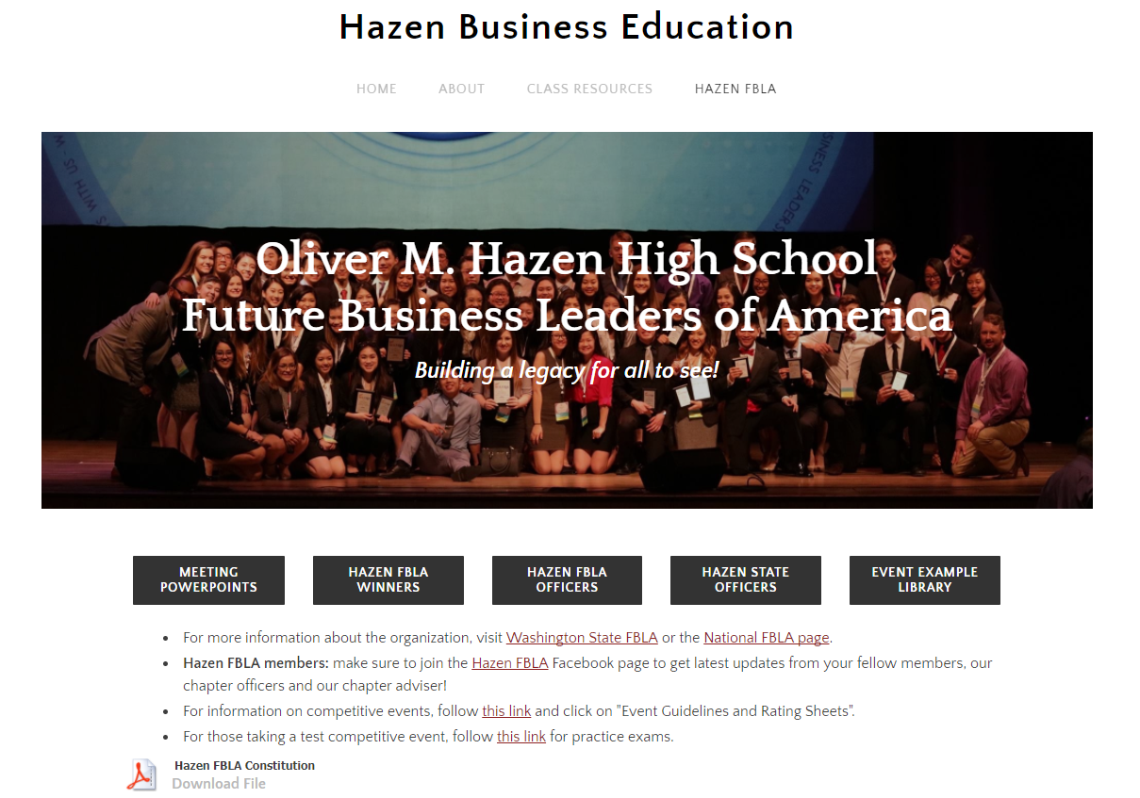
Resources: rustybized.weebly.com

Slide 14
Fundraising Opportunity!!!
When: Saturday, September 16, 2017, 7:00 AM – 12:30 PM
Location: Redmond Town Center
What: Sounders FC Rave Green Run
Assistance with registration, packet pickup, baggage check
Donation goes directly to your account specifically for FBLA events

Slide 15
Next Chapter Meeting:
When: Tuesday, September 26, 2:15 PM
Location: Lecture Hall
Discussion: Events, General Information, TBD
QUESTIONS?
See Rusty in room 103 at any time
peter.rustemeyer@rentonschools.us

